Slide 1
SIMPLE LINEAR REGRESSION · LECTURE 2
Deriving the OLS Formula from Scratch
Full end-to-end mathematics behind the best-fit line, plus building and testing the algorithm in Python without scikit-learn
Part 1: Mathematical derivation Part 2: Code it, test it, verify against scikit-learn
Machine Learning • Regression Series

Slide 2
ROADMAP
What We're Covering Today
This is an end-to-end lecture in two parts — the full math first, then the code, so you can check that both agree.
Recap
Two solution paths
1
2
Where Simple Linear Regression left off, and today's goal: find m and b.
Closed-form OLS vs. iterative Gradient Descent — and why both exist.
Build the loss function
Visualize it
3
4
Turn 'closest to every point' into a precise mathematical expression.
See why the error surface is a bowl, with geometric intuition for m and b.
Derive with calculus
Code it from scratch
5
6
Set partial derivatives to zero and solve for b, then m, step by step.
A Python class with fit() and predict() — no sklearn required.
Test & verify
7
Run it on real data and confirm it matches scikit-learn exactly.
Simple Linear Regression — From Scratch
2

Slide 3
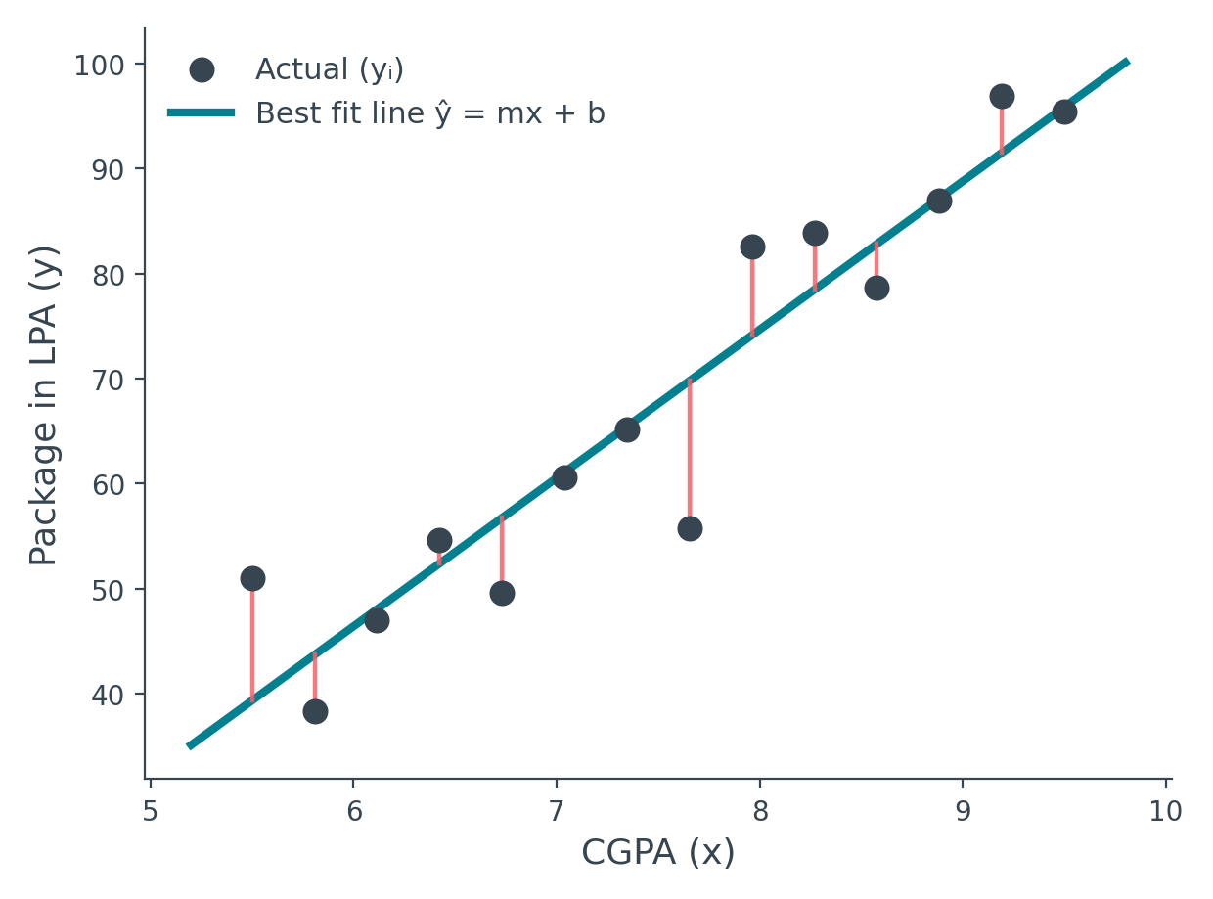
RECAP
The Dataset and the Goal
One input, one output. We're using the same placement dataset from last time: CGPA as input (x), placement package in LPA as output (y).
•
The data isn't perfectly linear
As CGPA increases, package roughly increases too — but points don't sit exactly on any line
•
So we approximate
We accept that no line can pass through every point, and instead look for the best fit line
•
Best fit means...
A line lying as close as possible to every point — minimizing total mistake, not eliminating it
•
We need two numbers
Points = actual students · Line = candidate best fit · Red = residual (error)
The line is ŷ = mx + b — the whole problem reduces to finding the right m and b
Simple Linear Regression — From Scratch
3

Slide 4
APPROACH
Two Ways to Compute m and b
Before diving into the math, it helps to know there are exactly two families of solution — and why each exists.
Σ
Closed-Form Solution
↓
Iterative Solution
A mathematical expression solvable in a finite number of standard steps (+, −, ×, ÷) — like the quadratic formula for ax²+bx+c=0.
For regression, this direct formula is called
Ordinary Least Squares (OLS)
— plug in the data, get m and b instantly.
No single formula gets you there. Instead, start from a guess and repeatedly nudge it closer to the answer.
For regression, this is called
Gradient Descent
— it uses differentiation at every step to walk downhill toward the minimum.
Simple Linear Regression — From Scratch
4

Slide 5
APPROACH
Where Each Technique Is Actually Used
Both give the same answer for linear regression — the choice is really about how well each scales.
Ordinary Least Squares (OLS)
Gradient Descent
In scikit-learn
LinearRegression class → uses OLS internally
SGDRegressor class → uses Gradient Descent
Best suited for
A small number of input features (low dimensions)
A large number of input features (high dimensions)
Speed & effort
Fast — one direct computation, no tuning needed
Needs iteration and a learning rate to tune
Today's focus
This is what we derive and code from scratch
Covered separately in its own lecture
Why not always use the direct formula? At high dimensions, the direct computation becomes computationally expensive — gradient descent scales better there.
Simple Linear Regression — From Scratch
5

Slide 6
DEFINITION
A Quick Detour: What Is a "Closed-Form Solution"?
A closed-form solution is a mathematical expression that can be reached in a finite number of standard operations — addition, subtraction, multiplication, division, and known functions — without needing an open-ended, repeated process.
Familiar example
The alternative
ax² + bx + c = 0
Non-closed-form problems
x = (−b ± √(b²−4ac)) ⁄ 2a
have no such shortcut. You must apply an approximation technique — repeating steps that gradually converge toward the answer.
The quadratic formula — plug in a, b, c and the roots pop out directly.
This is exactly what Gradient Descent does.
Good news for us: Simple Linear Regression does have a closed-form solution — the OLS formula we're about to derive.
Simple Linear Regression — From Scratch
6

Slide 7
THE GOAL
Find the Line With Minimum Total Error
For every student i, the vertical gap between their actual package and the line's predicted package is the residual — the model's mistake on that point.
dᵢ = residual for point i
Total error, first attempt
d₁ + d₂ + d₃ + ... + dₙ
The problem: some residuals sit above the line, some below — adding them directly lets positive and negative errors cancel out, hiding the true amount of mistake.
Simple Linear Regression — From Scratch
7

Slide 8
THE GOAL
Why Square the Error — Not Just |Error|?
Two candidate fixes for the cancellation problem: take the absolute value |dᵢ|, or square it dᵢ². We choose squaring, for two solid reasons.
1
Penalizes outliers more
2
Differentiable everywhere
Squaring grows faster than linear, so a point that is far from the line contributes disproportionately more to the total — pushing the fit to take large mistakes seriously.
To find a minimum, we need to differentiate the loss function. |x| has a sharp corner at zero — it is continuous but not differentiable there. x² is smooth everywhere.
|error| treats a mistake of 2 and a mistake of 20 proportionally — squaring does not.
Without a derivative at every point, our whole calculus-based approach later in this lecture would break down.
Simple Linear Regression — From Scratch
8

Slide 9
THE GOAL
One More Question: Why Power 2, Not 4?
Any even power removes the cancellation problem — 4, 6, 8 would all work mathematically. We use 2 simply because it's the smallest and simplest choice that does the job.
"If two works, why do four?" — simpler exponents mean simpler derivatives and faster computation, with no accuracy lost for this purpose.
Total error = d₁² + d₂² + d₃² + ... + dₙ²
What this quantity is called
Loss function
Cost function
Sum of Squared Errors (SSE)
The general ML term for the quantity we're minimizing — often written L
Used interchangeably with loss function in most textbooks
The specific name for this total (not averaged) version
Simple Linear Regression — From Scratch
9

Slide 10
COST FUNCTION
Writing the Full Loss Function E(m,b)
Replace each residual dᵢ with (actual − predicted), where predicted comes from our line ŷᵢ = mxᵢ + b:
dᵢ = yᵢ − ŷᵢ
yᵢ actual package for student i (from data)
ŷᵢ ("y-hat") predicted package from our line
dᵢ = yᵢ − (mxᵢ + b)
Now sum the square of this over all n points:
E(m,b) = Σ (yᵢ − (mxᵢ + b))² i = 1 to n
Note: this is a total (Sum of Squared Errors), not an average. Dividing by n would give the Mean Squared Error (MSE) instead — many textbooks use that version, but the minimizing m and b come out the same either way.
Simple Linear Regression — From Scratch
10

Slide 11
INSIGHT
The Only Things We Can Actually Change
Look closely at E(m,b) = Σ(yᵢ − mxᵢ − b)² — which symbols are free to move, and which are locked by the data?
Fixed by the dataset
Free to choose
xᵢ and yᵢ
m and b
Every student's CGPA and package is a constant, real number — we cannot change what's already in the CSV file.
These are the only knobs we control. Every line we could possibly draw corresponds to exactly one (m, b) pair.
These are constants in our equation, not variables.
So E is a function of exactly two variables: E(m, b).
Simple Linear Regression — From Scratch
11

Slide 12
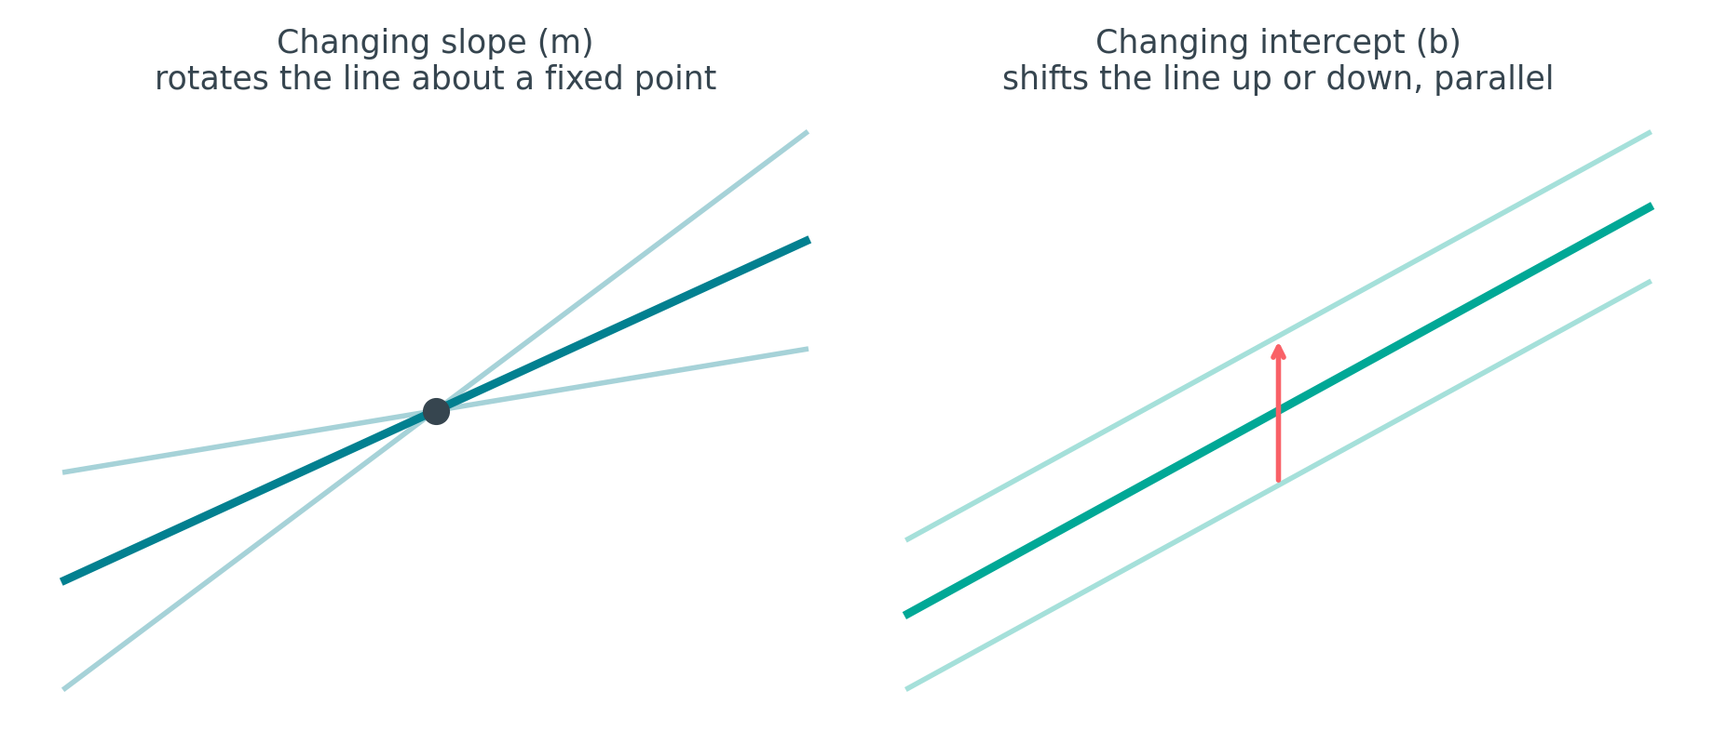
GEOMETRIC INTUITION
There Are Only Two Ways to Move a Line
In a 2D plane, every straight line reachable from another differs by exactly one, or both, of these transformations:
Rotate (change m): keep intercept fixed, vary slope. Shift (change b): keep slope fixed, vary intercept. Do both together for any line at all.
This is why it's logical that our error function depends on exactly these two variables — there is no third way to reposition a line.
Simple Linear Regression — From Scratch
12

Slide 13
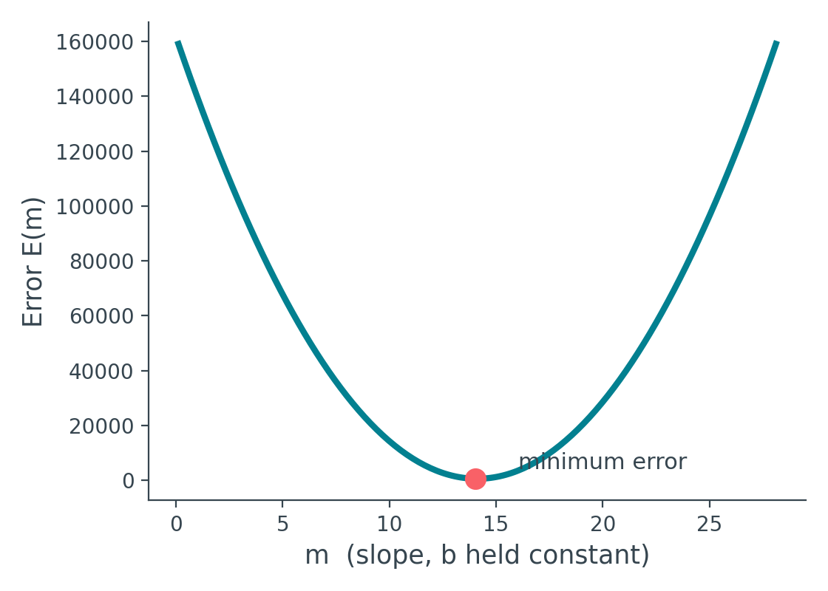
GEOMETRIC INTUITION
What Happens If We Vary m Alone?
Hold b fixed. As we rotate the line through different slopes, watch what happens to the total error:
Starting far from the right slope, error is high.
As m approaches the best value, error keeps falling.
Rotate past that point, and error starts climbing again.
The relationship between E and m traces a parabola — falls, bottoms out, rises again.
Simple Linear Regression — From Scratch
13

Slide 14
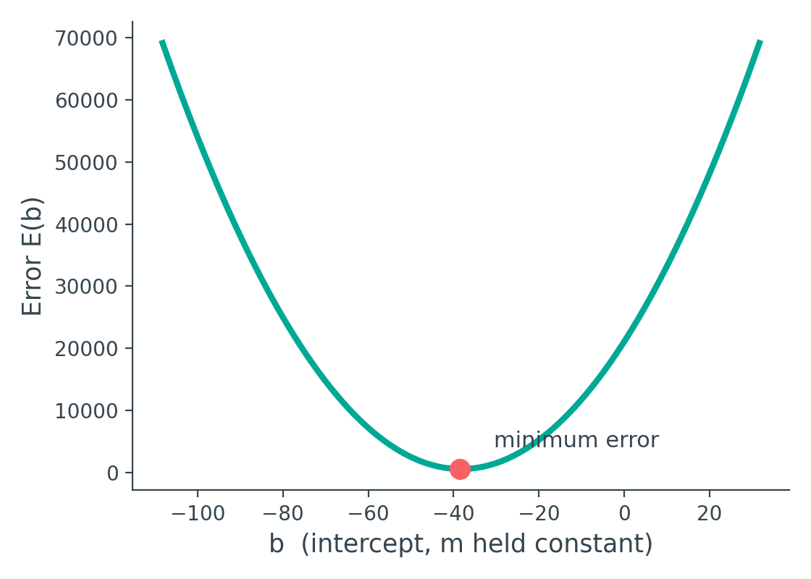
GEOMETRIC INTUITION
What Happens If We Vary b Alone?
Now hold m fixed. As we slide the line up and down, the same pattern appears:
Slide too far up or down, and the line drifts away from most points — error is high.
Somewhere in between, the line hugs the data — error hits a minimum.
Just like with m, the E-vs-b relationship is also a parabola.
Simple Linear Regression — From Scratch
14

Slide 15
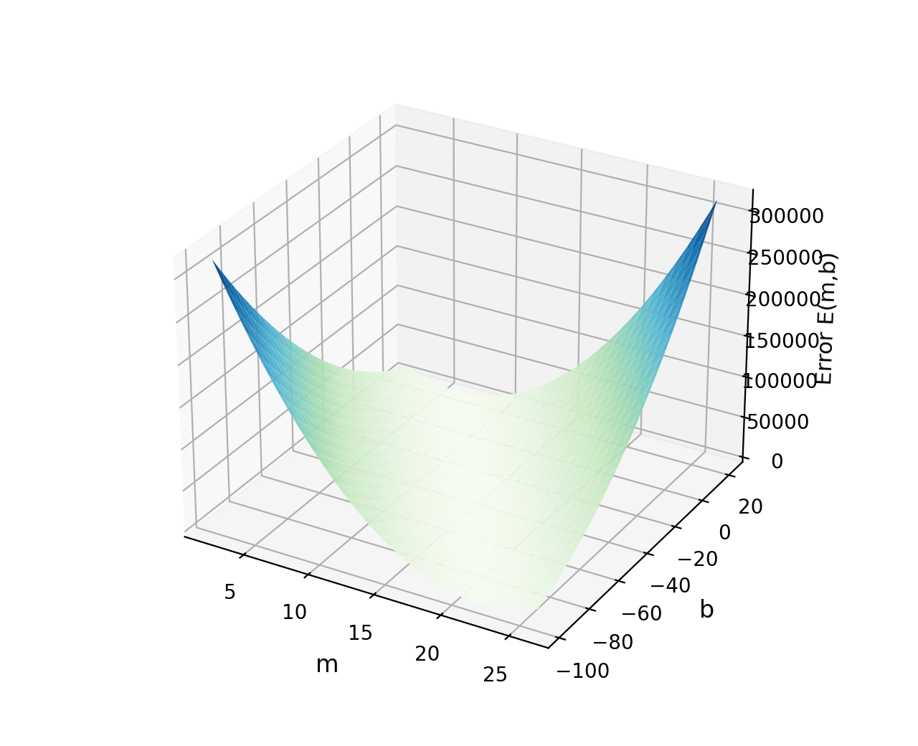
VISUAL INTUITION
Put Both Together: A Bowl-Shaped Surface
If varying m alone makes a parabola, and varying b alone makes a parabola, then plotting E against both m and b at once produces a 3D surface — shaped like a valley, or a bowl.
•
Walls rise on every side
Far from the ideal m, b, error grows steeply in any direction you move.
•
One lowest point exists
Exactly one (m, b) pair sits at the very bottom, where error is smallest.
•
Flat at the bottom
At that lowest point, the surface briefly stops changing in every direction — slope is zero there.
Simple Linear Regression — From Scratch
15

Slide 16
CALCULUS
Finding the Bottom of the Bowl: Set Slope = 0
For an ordinary single-variable function like f(x) = x² − 4x + 4, we find the minimum by differentiating and setting the result to zero — f'(x) = 0.
Our E(m,b) depends on two variables, not one — so we need the two-variable version: partial derivatives.
∂E / ∂b = 0
∂E / ∂m = 0
Differentiate w.r.t. b, holding m constant
Differentiate w.r.t. m, holding b constant
Two equations, two unknowns (m and b). We'll solve for b first — it turns out simpler — then substitute it in to solve for m.
1
2
3
4
Expand E(m,b)
∂E/∂b = 0
∂E/∂m = 0
Combine
Write Σ(yᵢ − mxᵢ − b)² out so it's ready to differentiate.
Apply the chain rule, simplify, isolate b.
Apply the chain rule again, substitute b, isolate m.
The two results are the final closed-form OLS formulas.
Simple Linear Regression — From Scratch
16

Slide 17
DERIVATION
Solving for b — Step by Step
Start
∂E/∂b = Σ 2(yᵢ − mxᵢ − b)(−1) = 0
Chain rule: derivative of the outer square, times derivative of the inner term w.r.t. b (which is −1)
Simplify
Σ (yᵢ − mxᵢ − b) = 0
Divide both sides by the constant −2
Split the sum
Σyᵢ − mΣxᵢ − nb = 0
A sum splits over subtraction; Σb added n times becomes nb
Isolate b
nb = Σyᵢ − mΣxᵢ
Move the b-term to one side
b = Σyᵢ/n − mΣxᵢ/n = ȳ − mx̄
Simple Linear Regression — From Scratch
17

Slide 18
DERIVATION
What the Formula for b Tells Us
b = ȳ − m · x̄
•
x̄ and ȳ are means
The average CGPA and average package across all n students in the training data.
•
The line passes through (x̄, ȳ)
Rearranging gives ȳ = m·x̄ + b — exactly the equation of the line at x = x̄. The best-fit line always crosses the data's own centroid.
•
b falls right out, once m is known
This formula needs no search — as soon as we have m, b follows in one direct calculation.
Simple Linear Regression — From Scratch
18

Slide 19
DERIVATION
Solving for m — Step by Step
∂E/∂m = Σ 2(yᵢ−mxᵢ−b)(−xᵢ) = 0
Chain rule again — this time the inner derivative w.r.t. m is −xᵢ
Start
Σ xᵢ(yᵢ−mxᵢ−b) = 0, then plug in b = ȳ − mx̄
Divide by −2; replace b with what we found on the previous slide
Simplify & substitute
Σ(xᵢ−x̄)(yᵢ−ȳ) = m · Σ(xᵢ−x̄)²
After expanding and simplifying, every remaining m collects on one side
Expand and collect m terms
m = Σ (xᵢ − x̄)(yᵢ − ȳ) ⁄ Σ (xᵢ − x̄)²
Simple Linear Regression — From Scratch
19

Slide 20
DERIVATION
What the Formula for m Tells Us
m = Σ(xᵢ−x̄)(yᵢ−ȳ) ⁄ Σ(xᵢ−x̄)²
Numerator
Denominator
Σ(xᵢ−x̄)(yᵢ−ȳ)
Σ(xᵢ−x̄)²
Measures how x and y vary together — a covariance-like term. Positive when both move in the same direction from their means.
Measures how much x alone varies — the spread of x around its own mean. Always positive, so it only scales the slope, never flips its sign.
Together, these two boxed formulas for m and b fully define the best-fit line — this is the complete closed-form OLS solution.
Simple Linear Regression — From Scratch
20

Slide 21
THE OLS FORMULAS
What Simple Linear Regression Actually Computes
SLOPE (m)
INTERCEPT (b)
Σ(xᵢ−x̄)(yᵢ−ȳ)
─────────────
Σ(xᵢ−x̄)²
b = ȳ − m · x̄
Both formulas need only two things from the data: the mean of x, the mean of y, and each point's distance from those means. No iteration, no learning rate, no guesswork.
Next: translate these two formulas directly into a Python class — fit() and predict().
PART 2 STARTS HERE → FROM MATH TO CODE
Simple Linear Regression — From Scratch
21

Slide 22
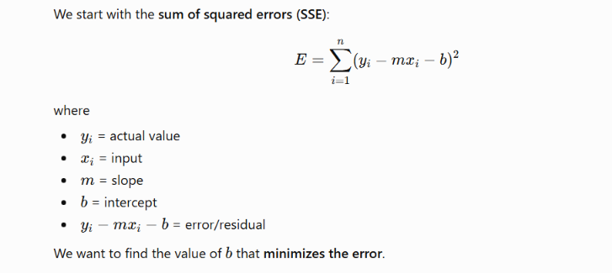

Slide 23
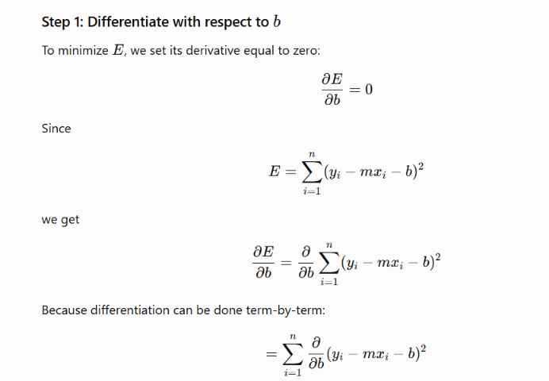

Slide 24
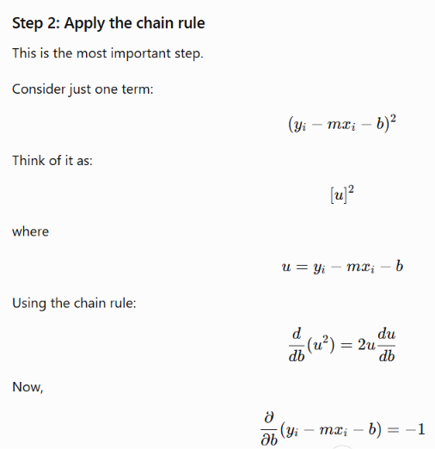
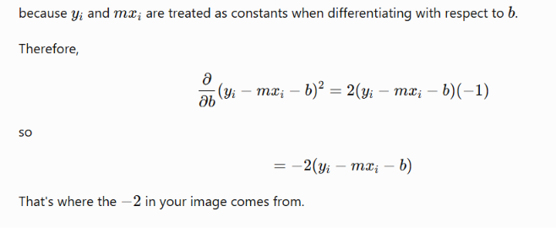

Slide 25
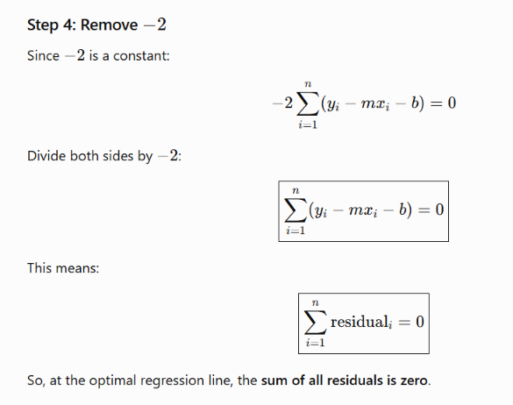
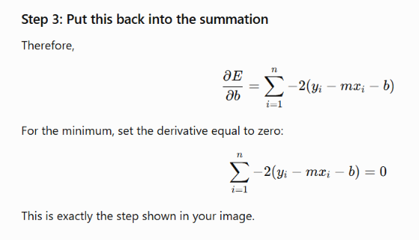

Slide 26
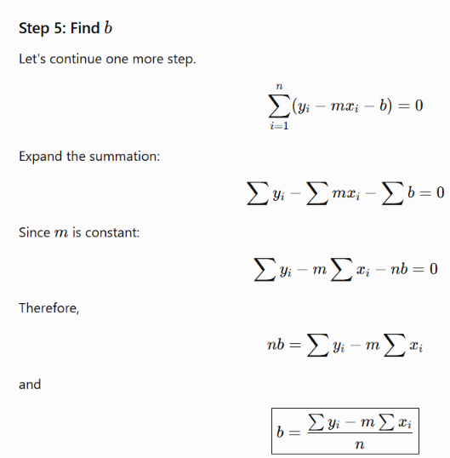
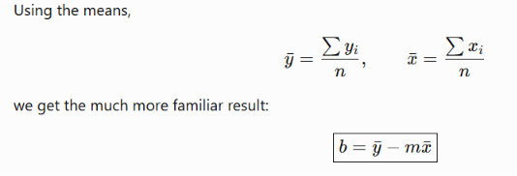

Slide 27
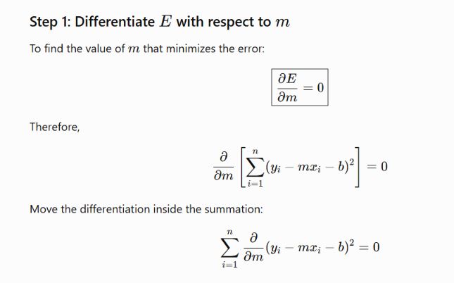

Slide 28
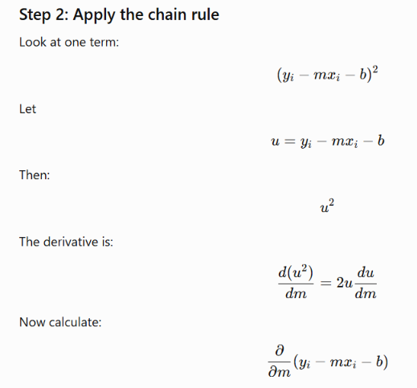
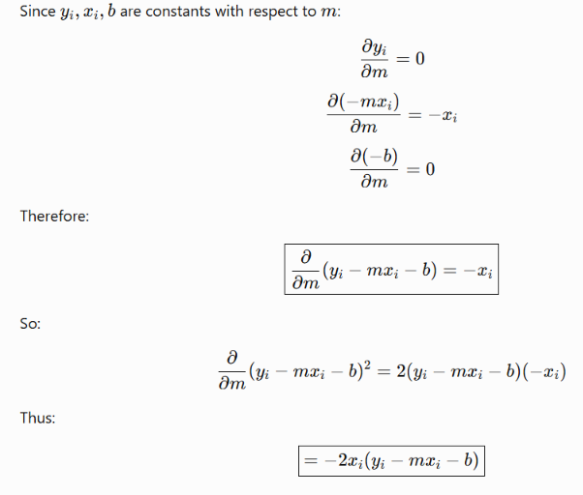

Slide 29
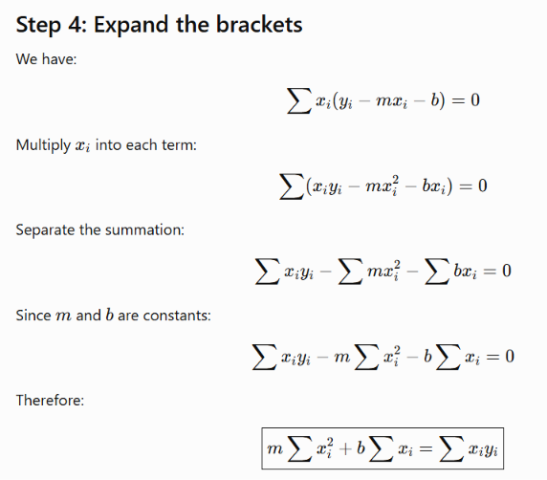
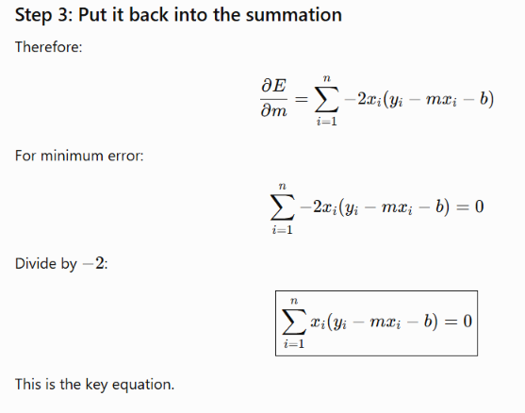

Slide 30
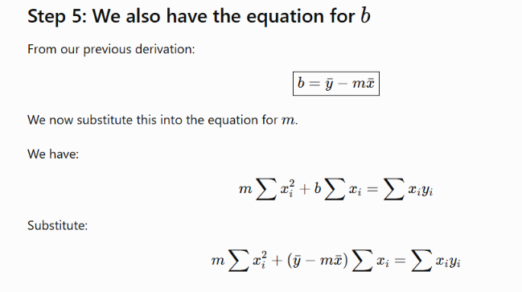

Slide 31
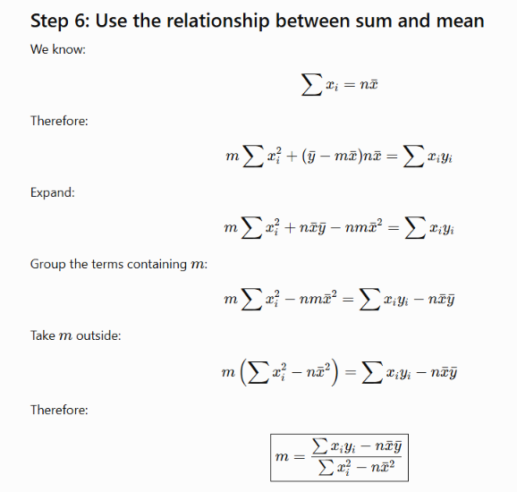
This is the standard formula for the slope in simple linear regression.

Slide 32
IMPLEMENTATION
Designing the Class, sklearn-Style
Every scikit-learn estimator follows the same shape. We'll mirror it exactly, so our class can be used the same way as sklearn's own LinearRegression.
__init__()
Set up empty state
self.m = None and self.b = None — nothing is learned yet
fit(X_train, y_train)
Learn from data
Runs the OLS formulas over the training set to compute self.m and self.b
predict(X_test)
Use what was learned
Returns self.m * X_test + self.b for any new input
Simple Linear Regression — From Scratch
22

Slide 33
IMPLEMENTATION
The Full Class: MeraLR
Note the class name — a playful "MeraLR" ("My Linear Regression"), so it's never confused with sklearn's own.
class MeraLR:
def __init__(self):
self.m = None
self.b = None
def fit(self, X_train, y_train):
num = 0
den = 0
for i in range(X_train.shape[0]):
num += (X_train[i] - X_train.mean()) * \
(y_train[i] - y_train.mean())
den += (X_train[i] - X_train.mean()) ** 2
self.m = num / den
self.b = y_train.mean() - (self.m * X_train.mean())
def predict(self, X_test):
return (self.m * X_test) + self.b
Simple Linear Regression — From Scratch
23

Slide 34
IMPLEMENTATION
Inside fit(): Mirroring the Math Exactly
Every line of the loop is a direct translation of the OLS formulas we derived — nothing new is introduced here.
for i in range(X_train.shape[0])
Loop once per training row — X_train.shape[0] is the number of students, n
num += (X[i]-X̄)*(y[i]-ȳ)
Accumulates the slope's numerator, one point's contribution at a time
den += (X[i]-X̄)**2
Accumulates the slope's denominator the same way
self.m = num / den
Exactly the boxed slope formula: m = Σ(xᵢ−x̄)(yᵢ−ȳ) / Σ(xᵢ−x̄)²
self.b = y.mean() - self.m*X.mean()
Exactly the boxed intercept formula: b = ȳ − m·x̄
Simple Linear Regression — From Scratch
24

Slide 35
TESTING
Setting Up the Test — Same Dataset as Before
To make the comparison fair, we reuse the exact placement dataset and exact train/test split from the previous lecture.
df = pd.read_csv('placement.csv')
X = df.iloc[:, 0].values # CGPA
y = df.iloc[:, 1].values # Package (LPA)
X_train, X_test, y_train, y_test = train_test_split(
X, y, test_size=0.2, random_state=2
)
print(X_train.shape) # (160,)
test_size = 0.2
20% of the data held back purely for testing — 80/20 split
random_state = 2
Fixes the shuffle, so results are reproducible and comparable to last lecture
X_train.shape → 160
Out of the full dataset, 160 rows are used to train the model
Simple Linear Regression — From Scratch
25

Slide 36
TESTING
Training the Model and Reading Off m, b
Create the object, call fit(), and the two formulas run automatically inside the loop we just walked through.
lr = MeraLR()
lr.fit(X_train, y_train)
print(lr.m) # slope
print(lr.b) # intercept
Result
Matches the m and b obtained via sklearn's LinearRegression in the previous lecture — exactly.
Why this matters: two completely different code paths — sklearn's optimized internals, and our raw Python loop — arrive at the same numbers, because both are solving the identical OLS formula.
Simple Linear Regression — From Scratch
26

Slide 37
TESTING
Predicting on Test Data — Then Verifying
Run predict() on the held-out test set, and sanity-check individual predictions against sklearn's model on the same rows.
lr.predict(X_test[0])
# returns (self.m * X_test[0]) + self.b
✓ MeraLR's prediction matches scikit-learn's LinearRegression prediction on the same test point.
A gotcha to watch for: if you edit the class definition and re-run, you must re-create the object (lr = MeraLR()) before calling fit() again — otherwise you're still working with the old, unedited object.
Simple Linear Regression — From Scratch
27

Slide 38
IMPORTANT CAVEAT
Where This Exact Approach Stops Working
MeraLR, as written, is built for Simple Linear Regression only.
It uses one input feature — this exact loop and formula won't extend to Multiple Linear Regression, where there are several input features at once.
•
sklearn's LinearRegression is different inside
It uses a more general, vectorized formulation internally — so the same class already handles multiple features without modification.
•
Coming in the next lecture
We'll extend today's exact derivation approach to Multiple Linear Regression, and separately implement Gradient Descent for when direct computation doesn't scale.
Takeaway: understanding this derivation deeply is still the right foundation — multiple regression builds directly on the same minimize-the-squared-error idea.
Simple Linear Regression — From Scratch
28

Slide 39
KEY TAKEAWAYS
What We Covered Today
1
The goal
2
Why squared error
Find m, b minimizing total squared error between predictions and actual values.
Prevents cancellation, penalizes outliers, and stays differentiable everywhere.
3
The loss surface
4
The derivation
E(m,b) = Σ(yᵢ−mxᵢ−b)² is a bowl — one minimum, found where slope is zero.
Partial derivatives set to zero give b = ȳ−mx̄ and m = Σ(xᵢ−x̄)(yᵢ−ȳ)/Σ(xᵢ−x̄)².
5
The code
6
The verification
A from-scratch MeraLR class with fit() and predict() mirrors the math line for line.
Results match scikit-learn exactly — same formula, two implementations.
Coming up next: Multiple Linear Regression, and Gradient Descent from scratch.

